Slide 1


Welcome to the Self-Help Group Application
Our self-help group application is designed to provide a supportive community for personal growth and empowerment. Connect with like-minded individuals and access valuable resources for enhancing your well-being.
Sa
by Stephen Amani

Slide 2

The Need for a Supportive Community
Emotional Support
Empowerment
Everyone needs a safe space to share struggles and victories without judgment.
A supportive community empowers individuals to take charge of their lives and make positive changes.
Shared Experiences
Connecting with others who have faced similar challenges helps reduce feelings of isolation.

Slide 3
Features of the Application
User-Friendly Interface
Customized Goal Setting
Community Engagement Tools
The application features an intuitive and user-friendly interface, making it easy to navigate and utilize its various functionalities.
Members can set personalized goals and track their progress within the app, fostering a sense of accomplishment and motivation.
The application offers tools for active community engagement, including event organization, group messaging, and peer support forums.
Users can seamlessly access features such as discussion forums, resource libraries, and goal tracking.
The goal-setting feature enables users to break down their objectives into manageable tasks.
Users can share experiences, insights, and encouragement with fellow members.

Slide 4
Benefits of joining the self-help group
Supportive Community
Encouragement and Motivation
Joining the self-help group provides a supportive community that understands and empathizes with your challenges.
Members offer encouragement and motivation, helping you stay focused on your goals and overcome obstacles.
Accountability
Shared Resources
Being part of the group holds you accountable, keeping you committed to your personal growth and development.
Access to shared resources, tools, and knowledge that can accelerate your progress and success.

Slide 5


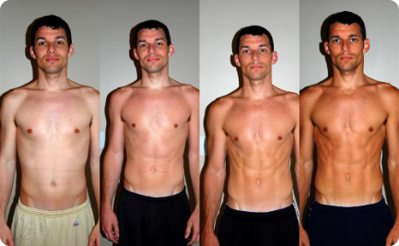
Success stories from existing users
Overcoming Challenges
Empowering Friendships
Transformative Journeys
Meet Sarah, who conquered her fears and achieved her goals with the support of the self-help group.
John found a community of like-minded individuals who became his pillars of support, leading to personal growth.
From self-doubt to confidence, witness the inspiring transformation of our user, Tina, through the group's encouragement.

Slide 6

How to get started with the application
Once you've downloaded the app, create your profile with your interests and goals. Explore the different groups available and join the ones that resonate with you. Start engaging with other members by sharing your experiences and offering support.
Don't hesitate to reach out to the community leaders for guidance. Set personal milestones and participate actively in discussions to get the most out of the app.

Slide 7
Pricing and subscription options
Basic Plan
Free
Premium Plan
$9.99/month
Group Plan
$19.99/month
Annual Subscription
Get 2 months free

Slide 8

Download the App and Join Today
Access Support Anytime, Anywhere
Exclusive Resources and Tools
Join an empathetic community ready to offer support round the clock.
Access a range of tools and resources designed to aid your personal growth journey.
Connect with Like-minded Individuals
Engage with a network of individuals sharing similar experiences and goals

Slide 9




Our Ask
Support
Collaboration
Community
Compassion
We encourage everyone to offer help and support to others in the group.
Let's work together to create a positive and supportive environment for everyone.
Building a strong sense of community is an essential part of our mission.
We aim to lead with kindness and compassion in our interactions with others.

Slide 10

Our Team
Our team is composed of dedicated individuals with diverse backgrounds and expertise.
We are committed to providing a supportive and inclusive platform for our members.

